Slide 1
Proposed
Capital project
and
Transportation vehicles
safety…security…pride
January 16, 2019

Slide 2
The connection between the environment in which our children learn and the impact on their performance is well-known. It is imperative, then, that we “build their future.”
When we invest in our school facilities and our transportation resources, we invest in the future of our children. They deserve a safe and secure learning environment that they can be proud of!
There is really no time better than now to take on the challenging task of aligning the quality of our facilities and transportation fleet with the expectations and desires we have for our students’ school experience and their overall achievement.
The future truly is NOW!

Slide 3
The February 12, 2019 vote contains 2 propositions:
Proposition 1:
Capital Improvement Project: $10,651,665
Proposition 2:
Transportation Vehicles: $417,000

Slide 4
Proposition 1: Capital Improvement Project
Allows us to take care of those “have-to” items that are beyond their useful life.
Infrastructure – safety, security, maintenance items that ensures the critical components in our buildings are updated.
Improve the safety and security of our schools while increasing our “hornets pride” – school/community pride becomes readily apparent across our campus.
Major systems in both buildings will be updated.
Community spaces in Jr. Sr. High are significantly updated and improved.
The completion of this project will allow us to move out of a maintenance mode and into an “enhancement/growth” mode!

Slide 5
Scope of work…W.A.O. Elementary
(HIGHLIGHTS)
Improve parent drop-off/pick-up
Walk-ways for students much safer
Closer to school for drop-off/pick-up
Traffic flow improved
Make entrance to campus more inviting
Roof replacement in the 5th/6th grade wing (entire building roof will be “new” after this)
Improve ventilation & airflow for students
Improved air and thermal comfort has a positive impact on concentration, health, behavior, and achievement
Security upgrades
New electrical feed relocated to a safer place

Slide 6
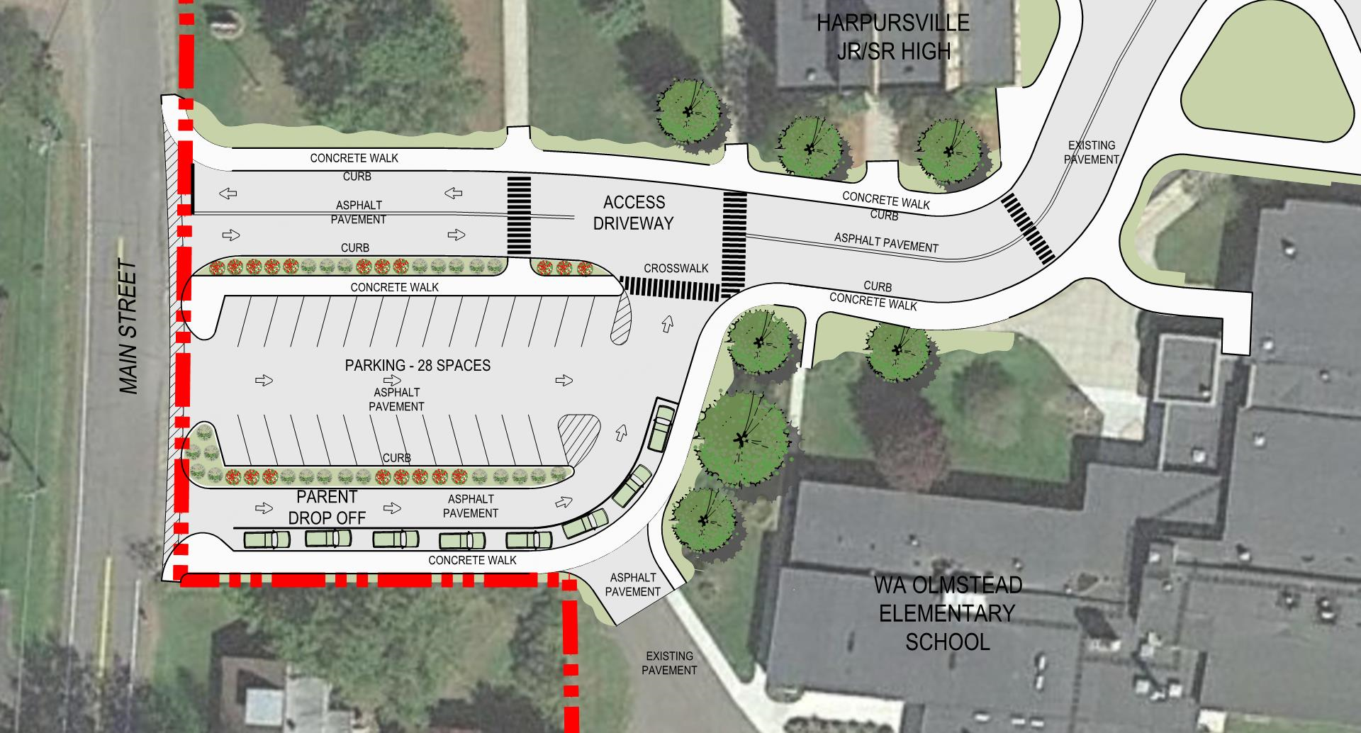

Slide 7
Scope of work …Jr. Sr. High
(HIGHLIGHTS)
Main entrance & courtyard enhancements (tied to septic tank)
Improve building security features
Blue gym gets a complete makeover; gold gym gets natural light
Auditorium gets a complete makeover – including A/C!
Improve ventilation & airflow for students
Improved air and thermal comfort has a positive impact on concentration, health, behavior, and achievement
Lighting upgrades in all areas of the building
The quality of light received by students impacts their achievement and health.
Significant roof replacement
Replace site septic tank (very important)

Slide 8
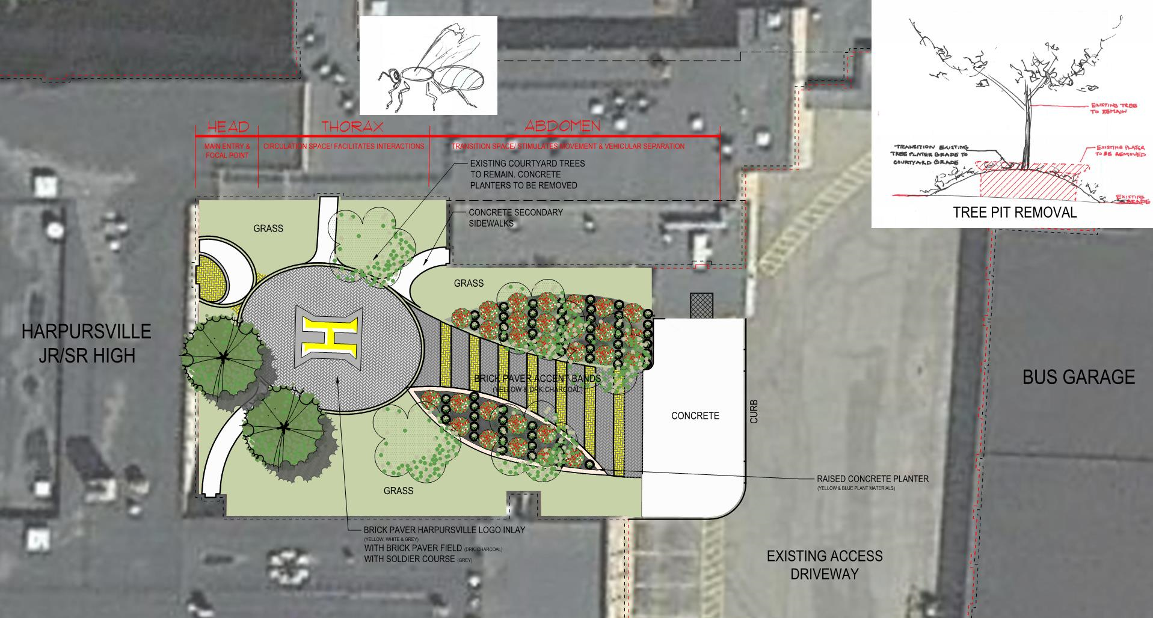
Jr. Sr. High
Courtyard & Entrance
Enhancing the entrance to the building & improving our facilities branding (i.e. growing our “hornet pride”).

Slide 9
Funding for the project
TOTAL PROJECT COST | $10,651,665
Capital Reserve | $504,550
Fund Balance | $500,000
Local Share | $9,647,115
Building Aid Ratio is about…93%
Smart School Money (applied after $ received) | $1,173,008
Average Levy Impact (per year for 15 years) | $49,030 (1.21%)
Average impact of 1.21% | $0.185 per $1,000
 | $18.50 on a $100,000 home
 | $1.54 per month

Slide 10
Timeline and plan moving forward
PROPOSED PROJECT TIMELINE
Phase | Start Date | End Date | Duration
Progress Meeting | Oct. 23, 2018 | Oct. 23, 2018 | - - -
Board of Ed. Presentation | Nov. 14, 2018 | Nov. 14, 2018 | - - -
Board of Ed. Action/SEQRA/Set Vote Date | Dec. 12, 2018 | Dec. 12, 2018 | - - -
Referendum/Vote | Feb. 12, 2019 | Feb. 12, 2019 | - - -
Design | Feb. 2019 | Oct. 2019 | 8 ½ months
3rd Party Expedited Review | Oct. 2019 | Dec. 2019 | 10 weeks
Bidding | Jan. 2020 | Feb. 2020 | 4 Weeks
Award/Start Up | March 2020 | April 2020 | 4 Weeks
Construction | May 2020 | Sept. 2021 | 17 months
Close Out | Oct. 2021 | Dec. 2021 | 3 months
Currently allocated 10 months for SED review. Expedited Review process is also an option to reduce review time (approx. 10 weeks)
Engage stakeholder groups:
Board of Education
Student group
Faculty & staff group
Community group
Design phase includes continued feedback to ensure final elements reflect needs of district, stakeholder input, code, etc. while being contained within cost structure.

Slide 11
Proposition 2: Transportation Vehicles
The total estimated cost of those vehicles is $416,687.72 (not to exceed $417,000)
3 buses at a price of $122,229.24 per Leonard Bus ($366,687.72)
2 minivans at an estimated cost of less than $25,000 a piece ($50,000)
Three buses to be traded in at a estimated savings of $16,500
Transportation aid is approx. 90%. (received over a 5-year period)
This purchase is part of and maintains the district’s fleet replacement plan – supports fiscal stability related to transportation and maintenance of sound fleet of vehicles

Slide 13
THANK YOU!
Go Hornets!

